Slide 1
Chapter 3: Measures of Central tendency
Part-2

Slide 2
Learning Outcomes
After Completing the chapter ,you will able to :
Compute the different types of mean, median and mode.
Understand the applications of different types of measures of central tendency.

Slide 3
Contents
    From this lecture, you are going to learn…
Computation of Median and Mode
Examples, Uses and limitations
Frequently Asked Questions (FAQs)

Slide 4

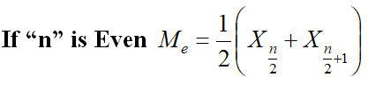
Median
Median:
Median is the middle value of the observations after they have been ordered from the smallest to the largest or from the largest to the smallest.
Median : After sorting the data
Smallest 50%
Largest 50%
Median value
Here, n=total number of observations

Slide 5



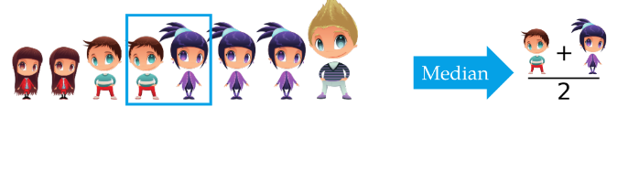

Median
Here, n=9
Here, n=8

Slide 6







Median
Example-1: Scores of 5 students in an exam have given below. Find median.
5, 14, 8, 11, 10.
Solution: After sorting the data:
Here, n is 5 which is odd number

Slide 7







Median
Example-2: Spending time per day (in hours) on social media of 12people has given below. Find median.
7,15,18,10,5,10,6,11,16,9,8,5.
Solution: After sorting the data:
Here the value of n is 12, which is even number.
So median is 9.5

Slide 8
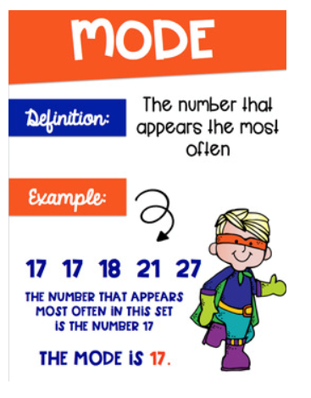
Mode
Mode:
The value which occurs with the highest frequency in the data set is called Mode.
Data can have more than one mode. If it has two modes, it is referred to as bimodal, three modes, tri-modal, and the like.
Example: The exam scores for ten students are: 81, 93, 84, 75, 68, 87, 81, 75, 81, 87.calculate mode
Solution: Because the score of 81 occurs the most often, it is the mode.
Example: 1,5,2,3,2,3.Find mode.
Solution: The list (1, 2, 2, 3, 3, 5) has the two modes 2 and 3.

Slide 9

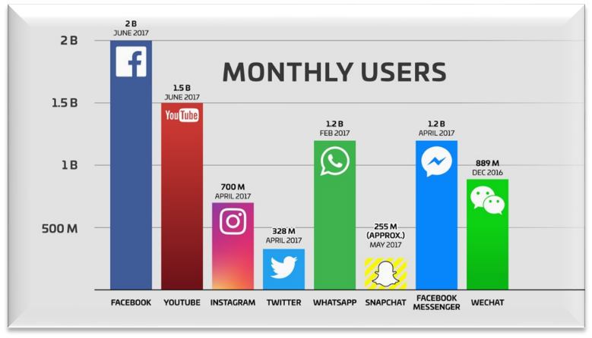




Mode
An example of qualitative variable
What is the most popular social media App?
Mode = Face book

Slide 10
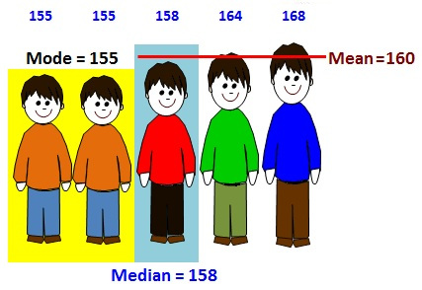

Mean, Median and Mode
Example:
The height of 5 people was found to be: 155 , 155, 158, 164, 168.Find Mean, Median and Mode.
Solution:
Mean =
=160
Median= 158(The middle value)
Mode=155(As 155 appears the most often)

Slide 11
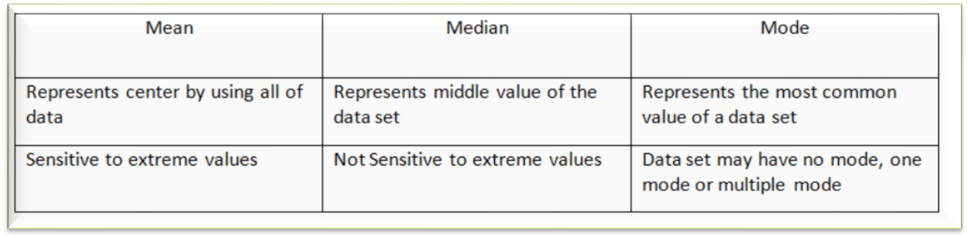
Comparison of mean, median and mode

Slide 12
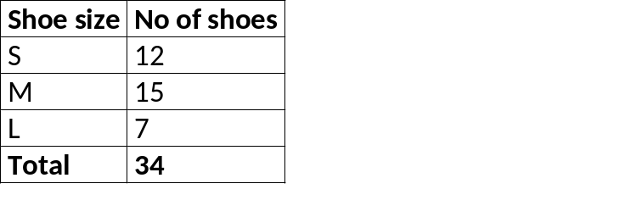
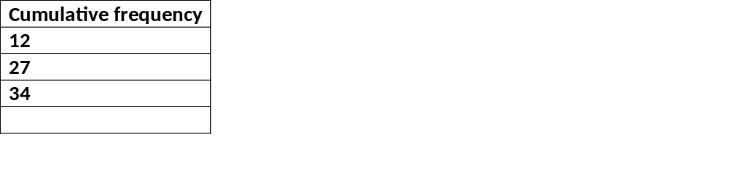

Measures of central tendency with different types of variables
The following summary table to know which measures of central tendency is applicable with respect to the different types of variable.
Type of Variable in terms of level | Applicable Measure of central tendency
Nominal to Ratio | Mode
Ordinal to Ratio | Median
Interval and Ratio | Mean
1. Nominal level data.
2. Ordinal level data
3. Interval level data
4. Ratio level data.
Mean
Median
Mode
34/2=17
Median=17th observation=Medium size.

Slide 13
FAQ’s about measures of central tendency
*Please find below some common questions that are asked regarding measures of central tendency, along with their answers.
What is the best measure of central tendency?
There can often be a "best" measure of central tendency with regards to the data you are analyzing, but there is no one "best" measure of central tendency. This is because whether we use the median, mean or mode will depend on the type of data we have (see our types of variables guide), such as nominal or continuous data; whether your data has outliers; and what you are trying to show from your data.
If there is outlier in dataset, what is the best indicator of central tendency?
It is usually inappropriate to use the mean in such situations. We would normally choose the median or mode, with the median usually preferred. This is discussed on the previous content under the subtitle, "When not to use the mean".

Slide 14
FAQ’s about measures of central tendency
Does all data have a median, mode and mean?
Yes and no. All continuous data has a median, mode and mean. However, strictly speaking, ordinal data has a median and mode only, and nominal data has only a mode.
When is the mean the best measure of central tendency?
The mean is usually the best measure of central tendency to use when our data distribution is continuous and symmetrical (no outlier) and quantitative variable, However, it all depends on what you are trying to show from your data.
When is the mode the best measure of central tendency?
The mode is the least used of the measures of central tendency and can only be used when dealing with nominal data. For this reason, the mode will be the best measure of central tendency (as it is the only one appropriate to use) when dealing with nominal data.

Slide 15
FAQ’s about measures of central tendency
When is the median the best measure of central tendency?
The median is usually preferred to other measures of central tendency when your data set is skewed (i.e., has outlier observations) or we are dealing with ordinal data. However, the mode can also be appropriate in these situations, but is not as commonly used as the median.
What is the most appropriate measure of central tendency when the data has outliers?
The median is usually preferred in these situations because the value of the mean can be distorted by the outliers. However, it will depend on how influential the outliers are. If they do not significantly distort the mean, using the mean as the measure of central tendency will usually be preferred.

Slide 16


